Slide 1
ShopEZ: E-commerce Application
Team Members
1. DHARMA V
2. KAMESH V
3. MOHAMED AMJAD A
4. BANDI GAURAV SANDEEP
5. BHARATH P

Slide 2
ABSTRACT
ShopEZ is a comprehensive e-commerce platform designed to enhance both the shopping experience for customers and the order management process for sellers. Built using the MERN stack (MongoDB, Express.js, React, and Node.js), ShopEZ delivers a seamless, secure, and efficient platform for online retail. With features like effortless product discovery, personalized recommendations, a secure checkout process, and insightful analytics, it aims to simplify e-commerce for both buyers and sellers.

Slide 3
INTRODUCTION
Online shopping has become essential in the digital age, but the challenge lies in making the process user-friendly for both customers and sellers. ShopEZ addresses these challenges by providing a streamlined platform that combines ease of use for customers with powerful tools for sellers.

Slide 4
Proposed System / Future Implementation
Enhance personalized recommendations using AI.
Implement real-time order tracking for customers.
Introduce a loyalty rewards system for repeat buyers.
Integration of a chat support system for real-time assistance.
Expand the dashboard analytics with advanced data visualization.
Advanced reporting tools for sellers with predictive analytics.
Integration with third-party logistics providers for faster delivery tracking.

Slide 5
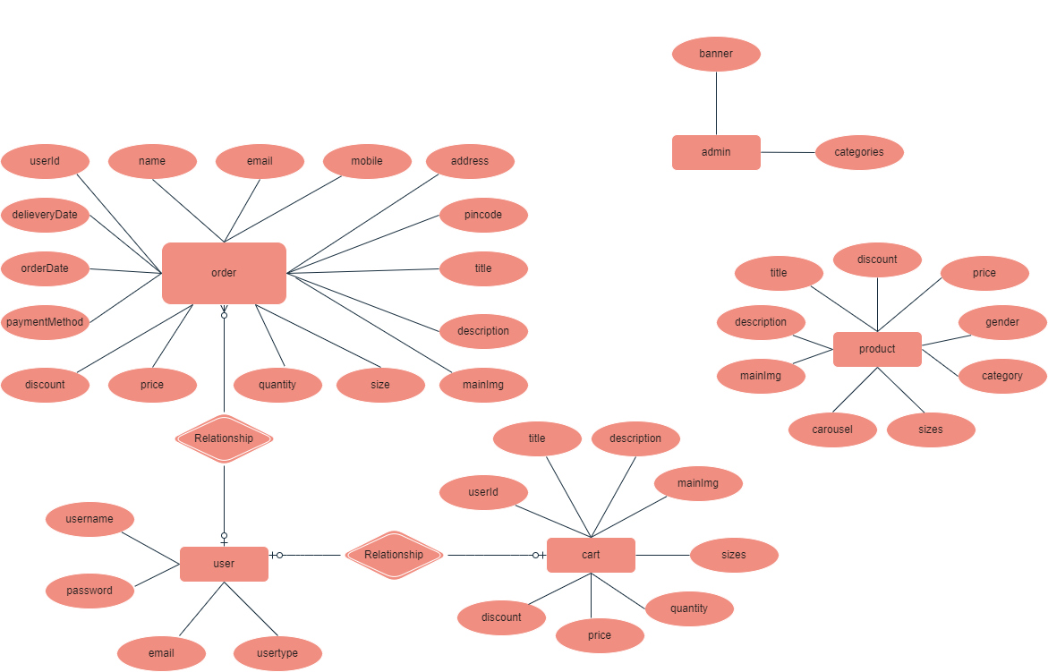
ARCHITECTURE DIAGRAM
rchitecture diagram

Slide 6
FRONTEND DEVELOPMENT
Framework: React.js for dynamic user interaction and seamless user experience.
Key Components:
User Profile Management: Allows users to update personal information and track orders.
Product Filters: Users can filter products by category, price, and rating.
Wishlist Functionality: Option to save items for future purchases.
Responsive Design: Works across desktop and mobile platforms for an optimized experience.
Integration with third-party libraries for animations and user engagement.

Slide 7
BACKEND DEVELOPMENT
Framework: Node.js with Express.js for building a scalable, event-driven backend.
Features:
REST APIs for CRUD operations on users, products, and orders.
Integration with MongoDB for storing user data, product catalog, and order histories.
Secure JWT Authentication to protect user and admin data.
Payment Integration: Supports multiple payment gateways like Stripe or PayPal.
Error Handling: Robust system for handling exceptions and logging.

Slide 8
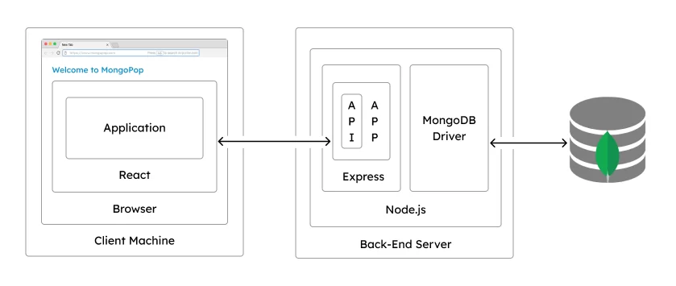

Slide 9
INTEGRATION
The integration of ShopEZ is designed to ensure seamless communication between the frontend and backend, providing a smooth user experience. The frontend, developed using React.js, interacts with the backend APIs built in Node.js and Express.js to handle tasks like user authentication, product retrieval, cart management, and order processing. The backend is integrated with MongoDB to store data for users, products, and orders efficiently.

Slide 10
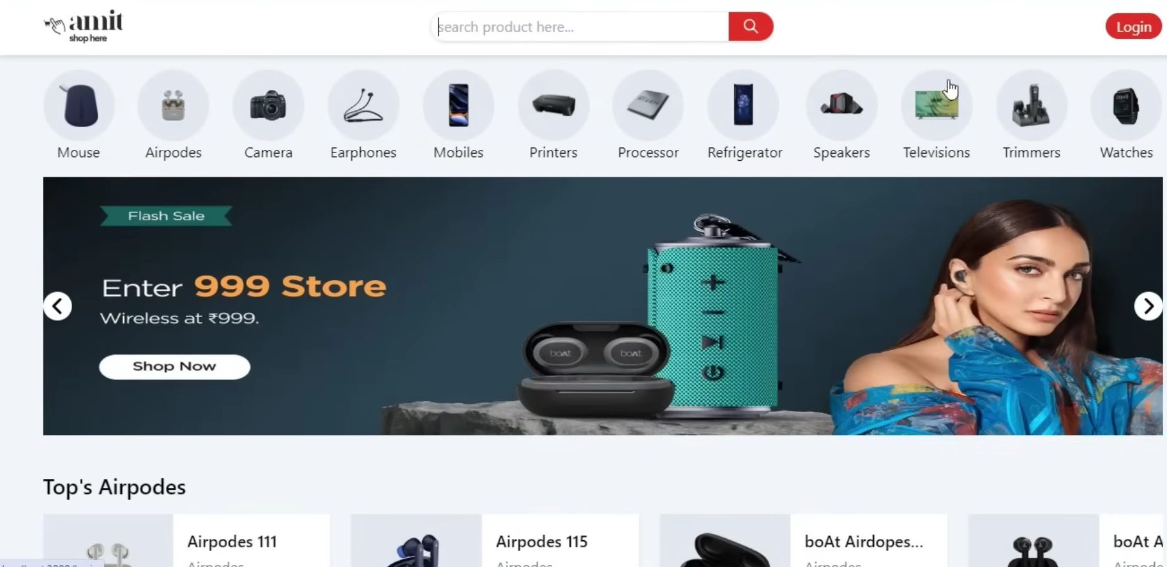
MODEL

Slide 11
CONCLUSION
ShopEZ provides a seamless and efficient e-commerce platform built with the MERN stack, offering users a smooth shopping experience with features like personalized product recommendations and an intuitive checkout process. Sellers benefit from a streamlined order management system and insightful analytics to support business growth. With planned future enhancements, such as more advanced product recommendation algorithms, ShopEZ is positioned to further improve the online shopping journey for both buyers and sellers.

Slide 12
THANK YOU

